Slide 1
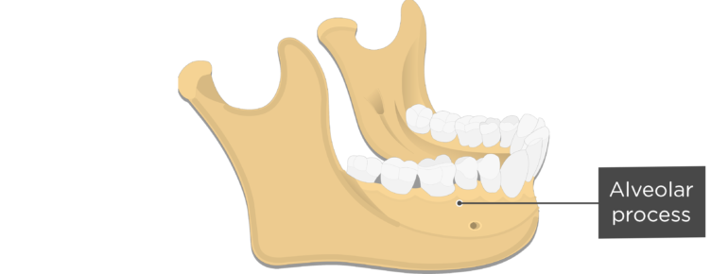

ALVEOLAR BONE
RUNGTA COLLEGE OF DENTAL SCIENCES AND RESEARCH,BHILAI
DR PUSHPENDRA YADAV
SR. LECTURER
DEPT. OF PERIODONTOLOGYY

Slide 2
SPECIFIC LEARNING OBJECTIVES
CORE AREAS | DOMAIN | CATEGORY
Introduction | Affective | Desire to know
Development | Cognitive | Must to know
Structure | Cognitive | Must to know
Composition | Cognitive | Must to know
Cellular components | Cognitive | Must to know
Bone remodeling | Cognitive | Must to know
Vascular supply | Cognitive | Must to know

Slide 3
content
Introduction
Development
STRUCTURE
Composition
Cellular Components
Bone Remodeling
Vascular Supply
Summary
Reference

Slide 4
Introduction
The alveolar process is the portion of the maxilla and mandible that forms and supports the tooth sockets (alveoli).
It forms when the tooth erupts to provide the osseous attachment to the forming periodontal ligament; it disappears gradually after the tooth is lost.

Slide 5
Development of alveolar process
At the end of 2nd month of fetal life maxilla and mandible forms a groove that is open toward the surface of oral cavity.
Tooth germs contained in this groove, also include alveolar nerves and vessels.
Gradually, bony septa develop between adjacent tooth germs

Slide 6
Alveolar process develops only during the eruption of the teeth and conversely, it gradually diminishes in height after the loss of teeth.
During growth part of it is gradually incorporated into the maxilary and mandibular body and rapidly grows at its free borders.

Slide 7
STRUCTURE OF ALVEOLAR BONE

Slide 8
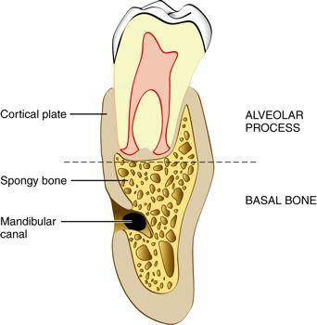
BASAL BONE
-portion of the jaw located apically, but unrelated to the teeth

Slide 9
The alveolar process is divisible into separate areas on an anatomic basis, but it functions as a unit, with all parts interrelated in the support of the teeth.
Most of the facial and lingual portions of the sockets are formed by compact bone alone; cancellous bone surrounds the lamina dura in apical, apicolingual, and interradicular areas

Slide 10
1
An external plate of cortical bone formed by haversian bone and compacted bone lamellae.

Slide 11
2
The inner socket wall of thin, compact bone
ALVEOLAR BONE PROPER,
seen as the lamina dura in radiographs.
Histologically, it contains a series of openings (cribriform plate)
through which neurovascular bundles link the periodontal ligament with the central component of the alveolar bone, the cancellous bone.

Slide 12
3
Cancellous trabeculae, between these two compact layers, which act as supporting alveolar bone.
The interdental septum consists of cancellous supporting bone enclosed within a compact border.

Slide 13
BONE COMPOSITION
CELLULAR
osteoblasts, osteoclasts, osteocytes, and bone lining cells.
Organic (35%)
EXTRACELLULAR
Inorganic(65%)

Slide 14
Organic(35%)
Type I collagen (90%)
Non collagenous protein
Osteocalcin
Osteonectin
osteopontin
Bone morphogenic protein
Phosphoprotein
Proteoglycan

Slide 15
INORGANIC
Composed principally of minerals such as:
      Calcium
      Phosphate
      Hydroxyl
      Citrate
      Carbonate

Slide 16
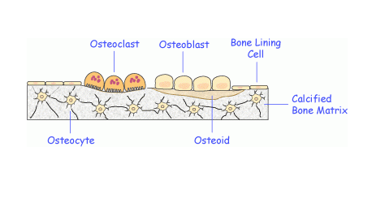

Slide 17
OSTEOBLASTS:
Cuboidal cells with well developed rough endoplasmic reticulum, a large golgi apparatus and secretory vesicles.
Derived from progenitor cells (mesenchymal family) at the site of bone formation.
Synthesizes bone matrix (osteoid), type 1 collagen and regulate its mineralization

Slide 18
OSTEOCLASTS:
Large multinucleated giant cells.
Derived from blood – borne monocytes.
Found in bay like depression in the bone called Howship’s lacunae.
Surface of cell near the bone is convoluted and ruffled secrets hydrolytic enzyme.
Ruffled border is surrounded by clear zone contains cytoplasm, associated with binding of cells to the bone.

Slide 19
OSTEOCYTES:
It enclosed within a space called lacunae within calcified matrix.
It extend processes into canaliculi that radiate from the lacunae.
Canaliculi brings oxygen and nutrients to the osteocytes through blood and remove metabolic waste products.
These are considered to be the nerve cells of the bone, maintaining balance between resorption and remodeling

Slide 20
BONE REMODELLING
Remodeling is the major pathway of bony changes in shape, resistance to forces, repair of wounds, and calcium and phosphate homeostasis in the body.
Bone remodeling involves the coordination of activities of cells from two distinct lineages, the osteoblasts and the osteoclasts, which form and resorb the mineralized connective tissues of bone

Slide 21
Regulation of bone remodelling is a complex process which involves hormones and local factors acting on the generation and the activity of the differentiated bone cells.
Bone contains 99% of body’s calcium ion and is the major source of calcium when the calcium blood levels decreases.

Slide 22
Decrease in calcium blood levels
Monocytes migration in the bone area
Activation of receptors on the parathyroid gland
Release of parathyroid hormones
Stimulates osteoblasts to secrete IL-1 & IL-6

Slide 23
Monocytes coalesces to form multinucleated osteoclasts
Resorption of bone
Calcium ion from hydroxyapetite is released into the blood and normalises the calcium level
Feed back mechanism of normal blood calcium levels turns off the secretion of PTH.

Slide 24
Activated osteoclasts have ruffled border from which hydrolytic enzymes are secreted and this enzyme digest the organic matrix along with the hydroxyapetite.
Breakdown of collagen from organic matrix releases various osteogenic substrates which in turn stimulates the differentiation of osteoblasts leading to bone deposition

Slide 25
There is an interdependancy between the osteoblasts and the osteoclasts in remodelling process which is called as Coupling.
The activity of osteoclasts and the morphology of ruffled border can be modified and regulated by hormones such as PTH and calcitonin, which has receptors on the osteoclast membrane.

Slide 26
Tencate described the sequence of events in the resorptive process a follows:
Attachment of osteoclasts to the mineralized surface of bone.
Creation of a sealed acidic environment through action of the proton pump, which demineralizes bone and exposes the organic matrix.
Degradation of the exposed organic matrix to its constituent amino acids by the action of the released enzymes, such as acid phosphatase and the cathepsin.
Sequestring of mineral ions and amino acids within the osteoclasts

Slide 27
The sequence consists of five phases:
Activation
Resorption
Reversal
Formation
Resting

Slide 28
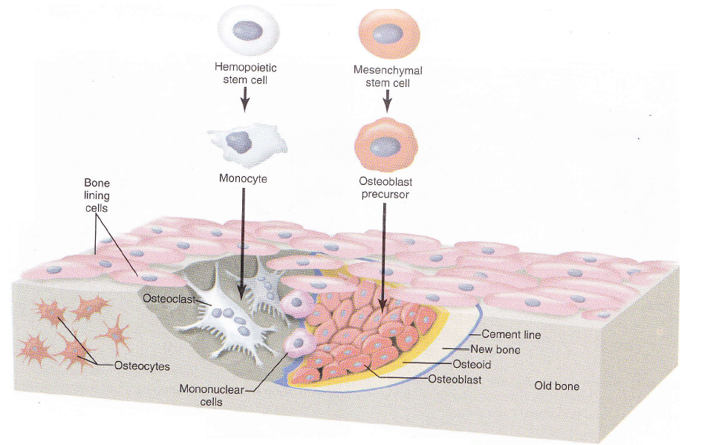

Slide 29
SOCKET WALL
Socket wall consists of dense lamellated bone which is arranged in haversian systems and bundle bone.
Bundle bone is the bone adjacent to the periodontal ligament that contains great number of sharpey’s fibers.
Bundle bone is localized within the alveolar bone proper.

Slide 30
Some sharpey’s fibers are completely calcified, but most have an uncalcified central core within the calcified outer layer.
Bundle bone is present throughout the skeletal system wherever ligaments and muscles are attached.

Slide 31
The cancellous portion of the alveolar bone consists of trabeculae enclosing marrow spaces lined with a layer of thin, flattened endosteal cells.
Trabecular pattern of cancellous bone is affected by the occlusal forces

Slide 32
Cancellous bone is found in the interdental and interradicular spaces and in limited amounts facially and lingually.
In human, more cancellous bone is present in the maxilla than in the mandible

Slide 33
BONE MARROW
In embryo and newborn the cavity of all bone are occupied by red hematopoietic marrow which gradually undergoes a physiologic change to the fatty or yellow inactive type of marrow.
In adult jaw the marrow is normally of the fatty type.

Slide 34
In some areas like maxillary tuberosity, the maxillary and mandibular molar and premolar areas, mandibular symphysis and the ramus angle, which may be visible radiolucent in the radiographs contains foci of red bone marrow, often accompanied by esorption of the bony trabeculae.

Slide 35
PERIOSTEUM AND ENDOSTEUM
The tissue covering the outer surface of the bone is termed as Periosteum, and the tissue lining the internal bone cavities is termed as endosteum

Slide 36
Periosteum consists of:
    Inner layer - composed of osteoblasts surrounded by osteoprogenitor cells, which have the potential to differentiate into osteoblasts.
    Outer layer – rich in blood vessels and nerves and composed of collagen fibers and fibroblasts.

Slide 37
Endosteum is composed of
inner layer of osteoblasts (osteogenic layer) and
the outer layer of connective tissue (fibrous layer).

Slide 38
INTERDENTAL SEPTUM
It consists of cancellous bone bordered by the socket wall cribriform plates (lamina dura or alveolar bone proper) of approximating teeth and the facial and lingual cortical plates.
In narrow interdental space the septum may consists of only the cribriform plate.
The mesiodistal angulation of the crest of the interdental septum is usually parallel to a line drawn between the CE junctions of the approximating teeth.

Slide 39
The distance between the alveolar crest and the CE junction in young adults varies from 0.75-1.49mm (average- 1.08mm) and this distance increases with age or due to periodontal disease to an average of 2.81mm

Slide 40
The mesiodistal and faciolingual dimensions and shape of the interdental septum are governed by:
the size and convexity of the crowns of the two approximating teeth, as well as
by the position of the teeth in the jaw and their degree of eruption.

Slide 41
OSSEOUS TOPOGRAPHY
The bone contour normally conforms to the prominence of the roots, with intervening depression.
Height and thickness of facial and lingual bony plates are affected by:
    Alignment of teeth
    Angulation of root to bone
    Occlusal forces.

Slide 42
On the teeth in labial version:
-facial bone margin is thinned to a knife edge and presents an accentuated arc in apical direction.
On the teeth in lingual version:
-facial bone margin is thick, blunt, rounded and horizontal.

Slide 43
The effect of root-to-bone angulation on the height of alveolar bone is most noticeable on the palatal roots of maxillary molars.
Bone margin is located farther apically on the roots, which forms relatively acute angles with the palatal bone.
Cervical portion of alveolar plate is sometimes thickened on the facial surface, as reinforcement against occlusal forces.

Slide 44
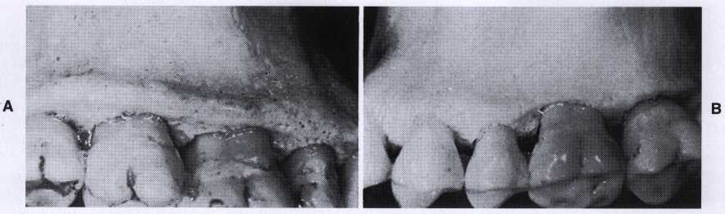

Slide 45
FENESTRATION:-
They are isolated areas in which the root surface is denuded of bone and covered only by the periosteum & overlying gingiva, but in these situation marginal bone remain intact.

Slide 46
DEHISCENCE :-
When denuded areas extend through the marginal bone, the defect is called dehiscence.
These defect are seen more on the facial bone than on the lingual bone.
They are more common on the anterior teeth than on the posterior and are frequently bilateral.
Etiology not clear.
Predisposing factor are:
- Root prominence
- Malposition
-Teeth in labial version
with thin bony plate.

Slide 47
BLOOD SUPPLY TO THE BONE
Vessels enter the interdental septa through nutrient canal along with veins, nerves, and lymphatics.
Alveolar arteries send off branches through periodontal ligament and enter marrow space through cribriform plate.

Slide 48
Blood vessels : derived from three sources:
- Branches in the periodontal ligament from apical vessels that supply the dental pulp;
- Branches from intra-alveolar vessels. these branches run horizontally, penetrating the alveolar bone to enter the periodontal ligament;
- Branches from gingival vessels, these enter the periodontal ligament from the coronal direction.

Slide 49
summary
The alveolar process is the portion of the maxilla and mandible that forms and supports the tooth sockets. The inner socket wall of thin, compact bone is called alveolar bone proper which is termed as lamina dura in radiographs.
The interdental septum consists of cancellous supporting bone enclosed within a compact border. The osteoblasts decreases with aging.

Slide 50
Reference
Newman MG, Takei HH, Klokkevold PR, Carranza FA. Carranza’s clinical periodontology, 10th ed. Saunders Elsevier; 2007.
Lindhe J, Lang NP and Karring T. Clinical Periodontology and Implant Dentistry. 6th ed. Oxford (UK): Blackwell Publishing Ltd.; 2015.
Newman MG, Takei HH, Klokkevold PR, Carranza FA. Carranza’s clinical periodontology, 13th ed. Saunders Elsevier; 2018.

Slide 51
THANK YOU

